Slide 1
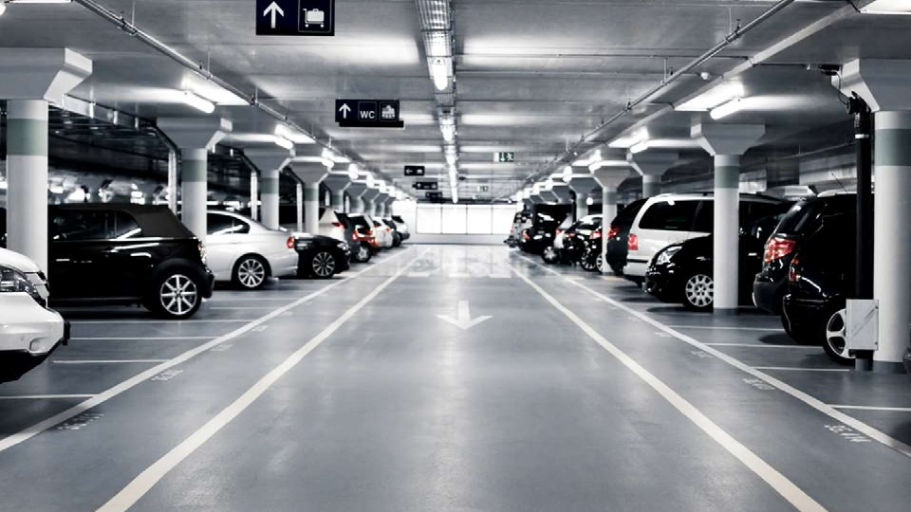
Online Parking
Booking
System
1

Slide 2

Content
➜Abstract
➜Introduction
➜Objectives
➜Modules
➜Advantages & Disadvantages
➜System Specification
➜System Design
➜System Development
➜Applications
➜Conclusion
2

Slide 3


ABSTRACT
➜In metropolitan areas, most vehicle drivers have the daily
concern of finding a vacant parking space especially during the rush hours.
➜So,
many parking management
systems
have
been
deployed in order to reduce such traffic congestion and
improve the convenience for vehicle drivers.
➜Current systems cannot guide the drivers to their desired
parking destinations.
3

Slide 4
HOW CAN WE FIND EFFECTIVELY
PARKING
SPACES???
4

Slide 5

1.
INTRODUCTION
5

Slide 6
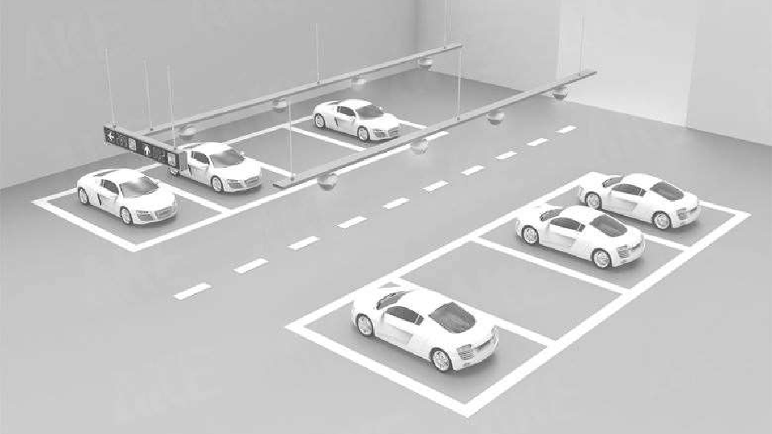

INTRODUCTION
➜Currently ,most of the existing car parking system are
manually managed and a little inefficient.
➜In urban areas, where number of vehicles is higher as
compared to the availability of parking spaces, a lot of time being wasted in searching for parking locations.
➜Hence online booking parking system is a proposed
method that users can reserve their parking places using web.
6

Slide 7


OBJECTIVES
➜Providing a simple web application for parking vehicles.
➜Booking for parking slot at home.
➜Parking owners can add their own parking places.
.
➜Make easy to automate parking owners and customers.
7

Slide 8

MODULES
➜User and Parking Owners login/registration
➜Parking booking online for date and time
➜Email on successful parking booking
8

Slide 9
ADVANTAGES OF SYSTEM
➜Users can get learn about parking areas for particular locations.
➜It saves user time in search of parking space available in such a
long parking area.
➜The system provides a graphical view of the parking spaces.
➜User can pay online on the spot and confirm their space.
➜It excludes the need of human efforts for managing parking
spaces.
➜The system generates online bill for requested time and even
sends an email.
➜Cost-effective.
9

Slide 10

DISADVANTAGES OF SYSTEM
➜
It
requires
an internet connection.
➜
It
requires
large
database.
10

Slide 11
2. SYSTEM
SPECIFICATION
11

Slide 12
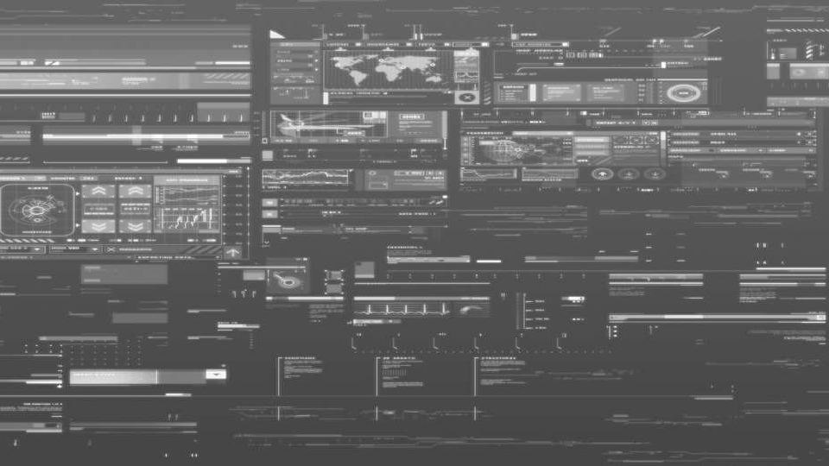
SOFTWARE REQUIREMENTS
1.MySQL Server
2.Apache
Tomcat Server
12

Slide 13
HARDWARE REQUIREMENTS
➢ Processor-i5
➢ Hard Disk-500 GB
➢ Memory-4GB RAM
13

Slide 14

SYSTEM
DESIGN
14

Slide 15

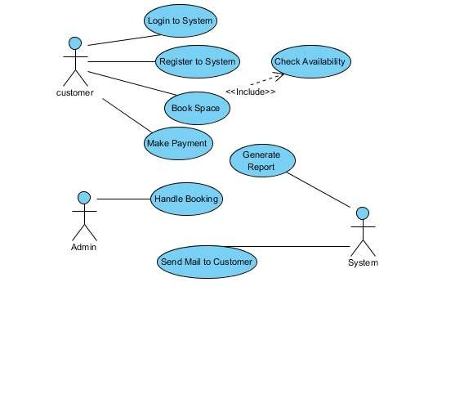
USE
CASE
DIAGRAM
15

Slide 16

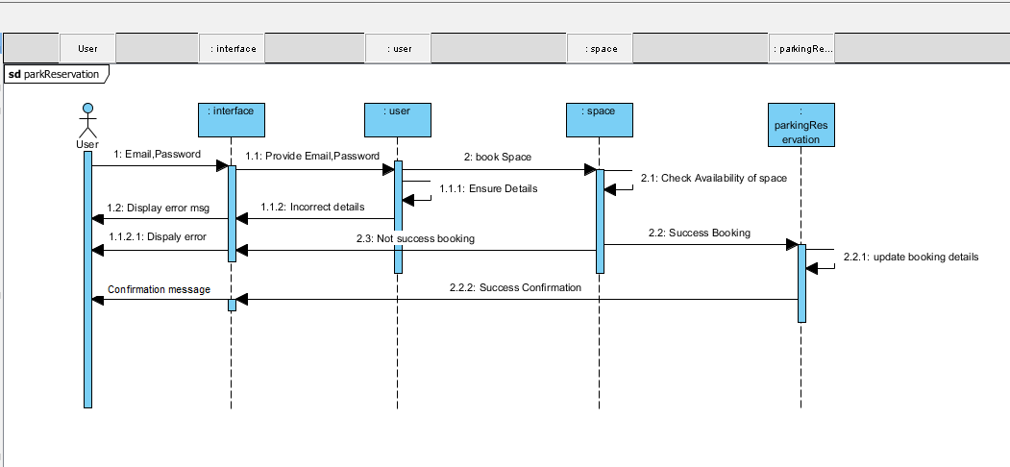
SEQUENCE DIAGRAM
16

Slide 17

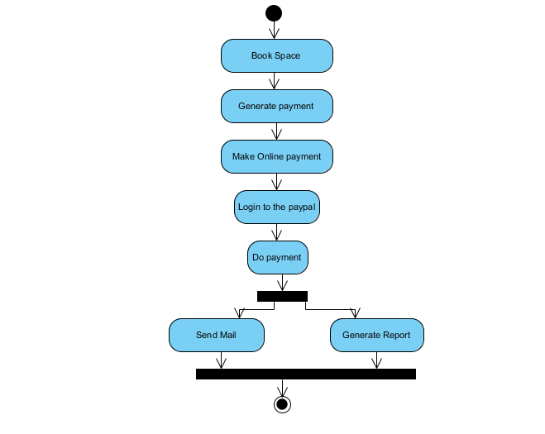
ACTIVITY DIAGRAM
17

Slide 18
SYSTEM
DEVELOPMENT
18

Slide 19
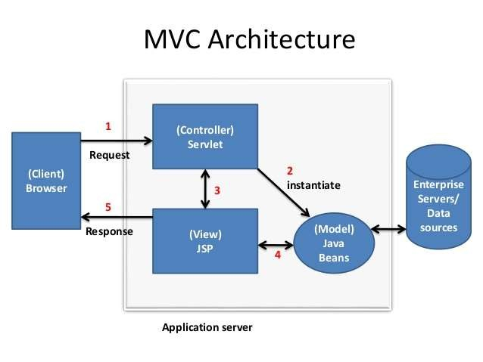
DEVELOPING ARCHITECRURE
19

Slide 20

DEVELOPING ENVIRONMENT TOOLS
20

Slide 21
APPLICATIONS
21

Slide 22
APPLICATIONS
➜The project can be implemented in commercial areas for
employee parking.
➜The system can also be used in public places for public
parking like in shopping malls, station, and restaurant.
22

Slide 23
CONCLUSION
23

Slide 24
CONCLUSION
➜As conclusion, the objective of online booking parking
system have been achieved.
➜The difficulty of
searching available parking slots has
been
completely eliminated
by
reserving lots
via
the
proposed system.
➜Users will get email on confirm booking
➜It saves user time in search of parking space available in such a long parking area
24

Slide 25

THANK
YOU
25

